Slide 1


SMART INDIA HACKATHON 2024
TITLE PAGE
Problem Statement ID – SIH1587
Organization: AICTE, MIC-Student Innovation
Problem Statement Title - Student Innovation
Theme – Disaster Management
PS Category- Software
Team ID -
Team Name – Ctrl+C/Ctrl+V

Slide 2
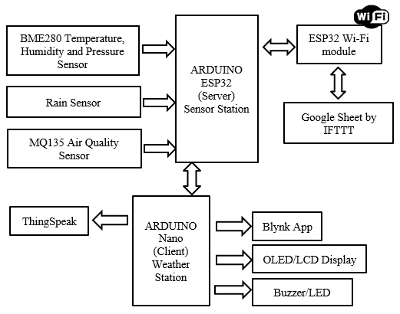
IDEA TITLE
Ctrl+C/Ctrl+V
Problem Statement: Cloud bursts cause severe flooding and landslides, their abrupt & unpredictable nature makes detection challenging. An Integrated Prediction System using Multi-Source Data Fusion offers early, reliable warnings to help mitigate disasters and protect communities.
Innovation & Uniqueness:
Multi-Layered Data Fusion: Integrates historical, real-time, and satellite data for precise predictions.
Enhanced Accuracy & Early Warnings: Combines imagery and real-time data for better risk management.
Adaptive System: Scales easily with new data sources and regions for evolving climate conditions.
Proposed Solution:
Our solution incorporates a unique 3-layer architecture:
Deep Learning Time Series Model: Uses meteorological data for cloud burst prediction.
Remote Sensing Satellite Imagery Model: Applies deep learning to satellite images for cloud formation monitoring.
Real-Time Data Collection Hardware: Uses sensors for real-time environmental data to refine predictions.
This layered approach allows us to tackle cloud burst prediction from both ground-level sensor data and high-altitude satellite observations.
Fig 1: Arduino Server & Weather Station Setup

Slide 3
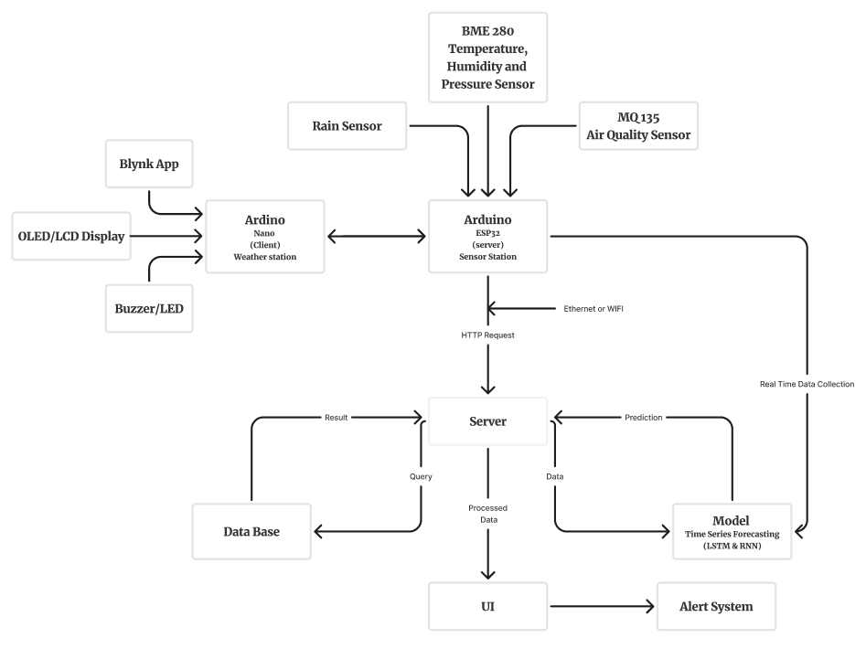
TECHNICAL APPROACH
Ctrl+C/Ctrl+V
Technology Stack:
ML & DL Frameworks:
TensorFlow, PyTorch, Keras
Weights & Biases
OpenCV, Yolov5, spaCy
Pandas, scikit-learn, Matplotlib, Seaborn, Plotly
DL Algorithms: RNN, LSTM, & CNN
Server-Side Handling: Python, Flask
Hardware:
Arduino (ESP32, Nano)
Sensors: DHT22, BMP180, LIDAR, Rain Gauge
DB: MySQL, PostgreSQL
ML-Ops:
Docker, Kubernetes
MLFlow, Data Version Control (DVC), Kubeflow, Terraform
User Interface: Next.js, Tailwind CSS
Deployment: AWS, GCP
Fig 2: Multi-layered System Architecture

Slide 4
FEASIBILITY AND VIABILITY
Ctrl+C/Ctrl+V
Idea Feasibility:
Potential Challenges & Risks:
Strategies for Overcoming Challenges:
Proven Technologies: Uses open-source framework and cost-effective hardware.
Scalable & Adaptable: LSTM and RNN handle large datasets with real-time inputs.
Seamless Integration: Cloud platforms ensure scalable and accessible deployment.
Optimized for Remote Operations: Low-power sensors and robust design ensure efficiency.
Data Retrieval & Quality: Processing large data can be computationally expensive and inconsistent.
Hardware Maintenance: Sensor calibration reliability in remote environments.
Connectivity Issues: Outages could interrupt data collection, especially in remote areas.
Model Adaptability: Performance may vary across different geographies and climates.
Model Integrity, Reliability & Consistency: Inconsistent data effects integration and other models.
Redundant Data Sources: Multiple data sources ensures reliability.
Robust Hardware Design: Regular calibrations & durable sensor installation.
Power Backup & Connectivity: Alternative power sources & communication methods.
Optimized Data Processing: Use of data augmentation techniques to manage costs.
Continuous Model Retraining: Regular updates improve performances across regions.

Slide 5
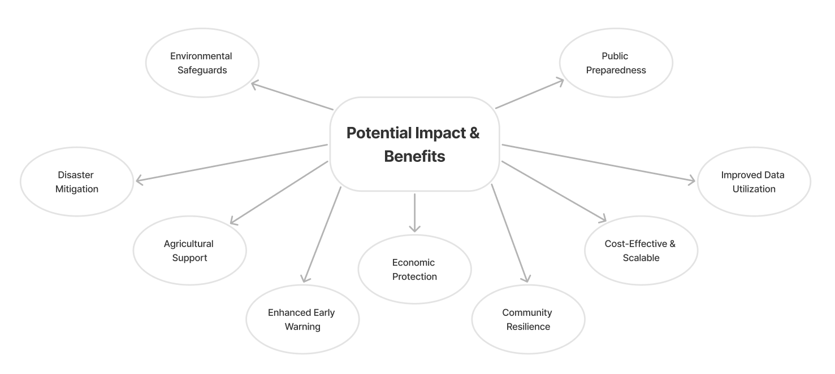
IMPACT AND BENEFITS
Ctrl+C/Ctrl+V
Use Cases:
Disaster Management & Response: Timely Evacuation Planning & Resource Allocation.
Agricultural Support: Crop & Livestock Protection, as well as Water Management for optimizing irrigation schedules and water usage.
Infrastructure Protection: Flood Control & Transportation (prevent accidents by closing roads which are at risk of landslides or floods).
Public Safety & Awareness: Mobile Alerts (push notifications) & Community Training for educating communities on disaster preparedness.
Environmental Conservation: Landslide Prevention & Wildlife Protection.
Urban Planning: Flood Mapping for designing better drainage systems & Resilient Design for construction of flood-resistant infrastructure.
Insurance Sector: Better Risk Assessment & Claim Processing with real-time post-disaster data.
Fig 3: Flowchart showcasing Impacts & Benefits

Slide 6
RESEARCH AND REFERENCES
Ctrl+C/Ctrl+V
Research Papers:
Related Articles:
Arduino, G., Reggiani, P., & Todini, E. (2005). Recent advances in flood forecasting and flood risk assessment. Hydrology and Earth System Sciences, 9(4), 280–284.
Srinivasan, J. (2013). Predicting and managing extreme rainfall. Current Science, 105(1), 7–8.
https://journals.ametsoc.org/view/journals/apme/43/12/jam2173.1.xml?tab_body=pdf
https://journals.ametsoc.org/view/journals/atsc/64/11/2006jas2375.1.xml?tab_body=pdf
https://journals.dbuniversity.ac.in/ojs/index.php/AJET/article/view/353
Thayyen, R. J., Dimri, A. P., Kumar, P., & Agnihotri, G. (2013). Study of cloudburst and flash floods around Leh, India, during August 4-6, 2010. Natural Hazards, 65, 2175–2204. doi:10.1007/s11069-012-0464-2.
National Conference on Advancements in Computer Science and Engineering. (2020). Rainstorm Prediction System. International Journal of Scientific Research in Science, Engineering, and Technology (IJSRSET).
Wikipedia Weather forecasting - Modern methods: https://en.wikipedia.org/wiki/Weather_forecasting#Modern_method
Arduino Block Diagram: https://www.researchgate.net/figure/Project-block-diagram_fig1_345327830
https://static1.squarespace.com/static/55774404e4b07f2c7dc881a0/t/5ec6c219b10cc30d341f7c8b/1590084123960/Modeling+Clouds+and+Wind.pdf
Open-Mateo API: https://open-meteo.com/
Objective: https://www.ijrti.org/papers/IJRTI2206303.pdf
https://techieyantechnologies.com/a-smart-weather-forecasting-system/
https://docs.arduino.cc/hardware/uno-rev3/
https://imdpune.gov.in/hazardatlas/index3.html
India Meteorological Department (IMD). (2013). A preliminary report on heavy rainfall over Uttarakhand during 16–18 June 2013. India Meteorological Department, Ministry of Earth Sciences.​
https://journals.ametsoc.org/view/journals/hydr/21/7/jhmD190287.xml?tab_body=abstract-display
https://www.tandfonline.com/doi/full/10.1080/02626667.2023.2235349

